Slide 1

A Castle Made of Sand
Adobe Reader X Sandbox
Richard Johnson
rjohnson@sourcefire.com
Notes:
Background = sandcastle

Slide 2
Adobe Acrobat
“Adobe Reader is free software that lets you open, view, search, digitally sign, verify, and print PDF files. To date, more than 600 million copies of Adobe Reader have been distributed worldwide on 23 platforms and in 33 languages”
http://www.adobe.com/products/reader/faq.html
Notes:
Today we will be talking about the Adobe Acrobat line of products (that handle pdf format), which are one of the most deployed (formats/applications)

Slide 3
Agenda
Why Adobe needs a sandbox
What's in a Sandbox
Windows Sandboxing
Adobe Reader Sandbox Architecture
Attacking Sandboxes
Conclusion
Notes:
Today we will be talking about the Adobe Acrobat line of products (that handle pdf format), which are one of the most deployed (formats/applications)

Slide 4
Internet Usage Statistics
As of June, 2010 there were 2 billion internet users
600 million Reader downloads = 30% market
Chrome market share was 23.8% in January, 2011
Roughly 476 million users
http://www.internetworldstats.com/stats.htm
http://www.w3schools.com/browsers/browsers_stats.asp

Slide 5
Adobe Acrobat Security History
Acrobat Reader CVE Vulnerabilities
Year | # of Vulnerabilities | DoS | Code Execution | Overflow | Memory Corruption | XSS | Http Response Splitting | Bypass something | Gain Privileges | CSRF | # of exploits
1999 | 1 |  | 1 | 1
2000 | 1 |  | 1 | 1
2001 | 1
2002 | 1
2003 | 3 |  | 2 | 1
2004 | 6 |  | 5 | 4
2005 | 9 | 4 | 5 | 3
2006 | 7 | 2 | 3 |  | 1 |  |  |  | 2
2007 | 9 | 3 | 3 |  | 1 | 2 | 1 |  |  | 1 | 1
2008 | 11 | 2 | 8 | 4 | 1 |  |  |  |  |  | 3
2009 | 39 | 14 | 30 | 17 | 10 |  |  | 1 | 1 |  | 4
2010 | 68 | 35 | 60 | 33 | 29 | 2 |  | 3 | 1 |  | 4
2011 | 28 | 10 | 22 | 8 | 8 | 2 |  |  | 4
Total | 184 | 70 | 140 | 72 | 50 | 6 | 1 | 4 | 8 | 1 | 12
% Of All |  | 38.0 | 76.1 | 39.1 | 27.2 | 3.3 | 0.5 | 2.2 | 4.3 | 0.5
http://www.cvedetails.com/product/497/Adobe-Acrobat-Reader.html?vendor_id=53
Notes:
As a highly deployed piece of software and the modern trend of client side attacks, it is worth noting the security track record of Adobe
Note vulnerability classes listed in the CVE table that did not affect Acrobat were omitted

Slide 6
Adobe Acrobat Security History
Acrobat CVE Vulnerabilities
Year | # of Vulnerabilities | DoS | Code Execution | Overflow | Memory Corruption | XSS | Bypass something | Gain Privileges | CSRF | # of exploits
2000 | 1 |  | 1 | 1
2003 | 3 |  | 2
2004 | 3 |  | 2 | 2
2005 | 2 | 1 | 1 | 1
2006 | 4 |  | 2 | 1 | 1 |  |  | 2
2007 | 4 | 1 | 1 |  |  | 2 |  |  | 1
2008 | 15 | 1 | 10 | 4 | 2 |  |  | 1 |  | 3
2009 | 49 | 18 | 39 | 22 | 14 |  | 2 |  |  | 4
2010 | 65 | 33 | 58 | 33 | 28 | 2 | 3 | 1 |  | 3
2011 | 28 | 10 | 22 | 8 | 8 | 2 |  | 4
Total | 174 | 64 | 138 | 72 | 53 | 6 | 5 | 8 | 1 | 10
% Of All |  | 36.8 | 79.3 | 41.4 | 30.5 | 3.4 | 2.9 | 4.6 | 0.6
http://www.cvedetails.com/product/921/Adobe-Acrobat.html?vendor_id=53
Notes:
As a highly deployed piece of software and the modern trend of client side attacks, it is worth noting the security track record of Adobe
Note vulnerability classes listed in the CVE table that did not affect Acrobat were omitted

Slide 7
Adobe Acrobat Security History
Adobe CVE Vulnerabilities
358 Vulnerabilities
278 Vulnerabilities lead to code execution
22 Exploits in the wild
15 Exploits achieve code execution
“During the Q1 2010, 48 percent of all exploits involved malicious PDFs, making Adobe Reader the most exploited software.”
http://www.esecurityplanet.com/article.php/3925701/RSA-New-Frontiers-in-Threat-Research.htm
Notes:
As a highly deployed piece of software and the modern trend of client side attacks, it is worth noting the security track record of Adobe
Note vulnerability classes listed in the CVE table that did not affect Acrobat were omitted

Slide 8
Google Chrome Security History
Chrome CVE Vulnerabilities
244 Vulnerabilities
36 Vulnerabilities lead to code execution
12 Exploits in the wild
3 Exploits achieve code execution
Notes:
As a highly deployed piece of software and the modern trend of client side attacks, it is worth noting the security track record of Adobe
Note vulnerability classes listed in the CVE table that did not affect Acrobat were omitted

Slide 9
Adobe Acrobat X
These statistics prompted a security push to make the next version of Adobe Acrobat significantly more resilient to hacking attempts
Adobe Acrobat X products have been hardened to utilize operating system provided mitigations on the Windows Platform
In addition, a new sandbox designed to limit the impact of successful exploitation attempts has been implemented

Slide 10
Use of Windows Mitigations
Address Space Layout Randomization
Adobe has modified all internal code to take advantage of random image mappings
Data Execution Prevention
Enabled with PERMENENT flag
“…Q2 of last year, PDF attacks fell to 30 percent...”
http://www.esecurityplanet.com/article.php/3925701/RSA-New-Frontiers-in-Threat-Research.htm

Slide 11
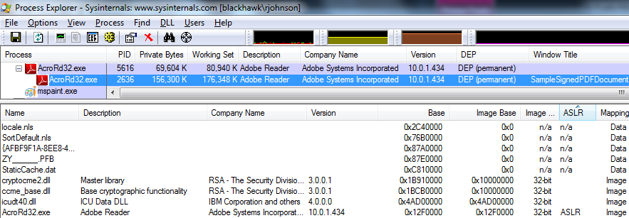
Windows Mitigations Fail
Sadly, 3rd party libraries that do not support ASLR can be forced to load via PDF
http://blogs.adobe.com/security/SampleSignedPDFDocument.pdf
Notes:
Standard ROP techniques apply with these libraries loaded
See HaifeiLi’s Flash exploitation talk for alternate techniques that may work

Slide 12
The Sandbox Concept
A sandbox is a mitigation strategy centered around the concept of isolating complex code into a lower privileged process which is managed by a higher privileged process
The higher privileged process is less prone to attack due to reduced attack surface and can restrict resources from a compromised lower privileged process
Notes:
Containment is key

Slide 13
Sandbox Architecture Requirements
Sandbox mitigations require the ability to:
Create a child process with restricted access to resources
Communicate between the processes to broker request access to resources

Slide 14
Sandbox Architecture on Windows
Process Restrictions
Restricted process tokens
Restricted process job object
IPC Mechanisms for System Call brokering
Sockets, Pipes, Shared Memory, Files, etc
Notes:
MS began implementing tokens in Windows 2000

Slide 15
Sandbox Architecture on Windows
Restricted process tokens
Create processes with restricted privileges
BOOL CreateRestrictedToken(
HANDLE ExistingTokenHandle,
DWORD Flags,
DWORD DisableSidCount,
PSID_AND_ATTRIBUTES SidsToDisable,
DWORD DeletePrivilegeCount,
PLUID_AND_ATTRIBUTES PrivilegesToDelete,
DWORD RestrictedSidCount,
PSID_AND_ATTRIBUTES SidsToRestrict,
PHANDLE NewTokenHandle
);
BOOL WINAPI CreateProcessAsUser(
HANDLE hToken,
LPCTSTR lpApplicationName,
LPTSTR lpCommandLine,
LPSECURITY_ATTRIBUTES lpProcessAttributes,
LPSECURITY_ATTRIBUTES lpThreadAttributes,
BOOL bInheritHandles,
DWORD dwCreationFlags,
LPVOID lpEnvironment,
LPCTSTR lpCurrentDirectory,
LPSTARTUPINFO lpStartupInfo,
LPPROCESS_INFORMATION lpProcessInformation
);
Notes:
MS began implementing tokens in Windows 2000
Drop authenticated Security Identifier (SID) to prevent opening a non-restricted process

Slide 16
Sandbox Architecture on Windows
Restricted job object
BOOL CreateCustomDACL(SECURITY_ATTRIBUTES * pSA) {
// Built-in guests are denied all access.
// Anonymous logon is denied all access.
// Administrators are allowed full control.
// Modify these values as needed to generate the proper
// DACL for your application.
TCHAR * szSD = TEXT("D:") // Discretionary ACL
TEXT("(D;OICI;GA;;;BG)") // Deny access to
// built-in guests
TEXT("(D;OICI;GA;;;AN)") // Deny access to
// anonymous logon
TEXT("(A;OICI;GA;;;BA)"); // Allow full control
// to administrators
if (NULL == pSA)
return FALSE;
return ConvertStringSecurityDescriptorToSecurityDescriptor(
szSD,
SDDL_REVISION_1,
&(pSA->lpSecurityDescriptor),
NULL);
}
HANDLE WINAPI CreateJobObject(
LPSECURITY_ATTRIBUTES lpJobAttributes,
LPCTSTR lpName
);
typedef struct _SECURITY_ATTRIBUTES {
DWORD nLength;
LPVOID lpSecurityDescriptor;
BOOL bInheritHandle;
} SECURITY_ATTRIBUTES, *LPSECURITY_ATTRIBUTES;
BOOL WINAPI AssignProcessToJobObject(
HANDLE hJob,
HANDLE hProcess
);
Notes:
MS began implementing job objects in Windows 2000 too
Assign process to job while suspended

Slide 17
Adobe Reader X Sandbox Design
Adobe enables the sandbox through a configuration option called ‘Protected Mode’
Separation of rendering code from basic process initialization and management code
25mb broker process
200mb rendering process

Slide 18
Adobe Reader X Sandbox Design
Rendering process has restricted tokens which disallow writing to the file system or executing new processes
Requests for system resources are denied and then requested from the broker process via a shared memory protocol
Requests are validated against internal policy

Slide 19
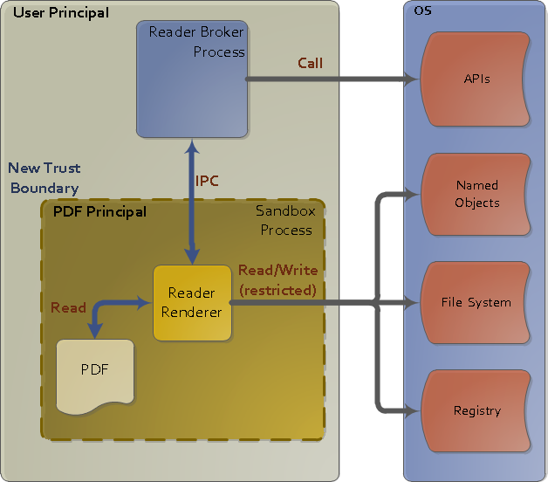
Adobe Reader X Sandbox Design
OS denies requests to resources
Broker gets request and checks ACLs
Broker gets resource and duplicates the handle
http://blogs.adobe.com/asset/2010/10/inside-adobe-reader-protected-mode-part-1-design.html

Slide 20
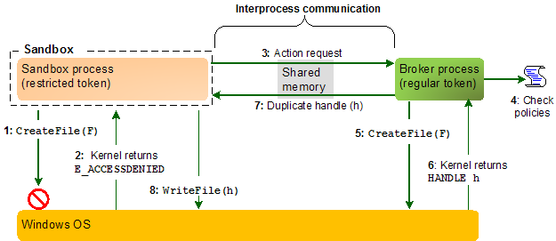
Adobe Reader X Sandbox Design
http://blogs.adobe.com/asset/2010/11/inside-adobe-reader-protected-mode-part-3-broker-process-policies-and-inter-process-communication.html

Slide 21
Adobe Reader X Sandbox Config
Configuration settings
JavaScript enabled by default
JavaScript global object security policy
JavaScript blacklist
ACLs for file, registry, process access
Log file disabled by default

Slide 22
JavaScript Blacklist
Blacklist is stored in the registry
Blacklist is capable of blocking API names
Withstands obfuscation methods
Does not come with any blocked by default
Blacklist cannot pattern match or prevent generic algorithms for spraying
More: http://vrt-blog.snort.org/2010/01/acrobat-javascript-blacklist-framework.html

Slide 23
Sandbox Analysis
Determine rights of separate processes
Determine IPC mechanisms in use
Validate resource requests are denied
Fuzz or audit broker resource request parser

Slide 24
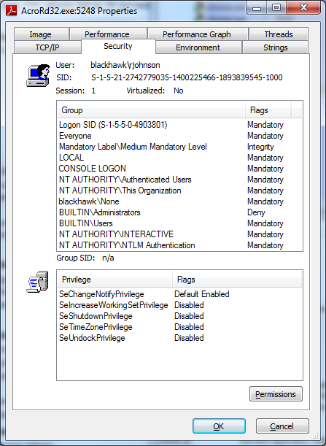
Sandbox Analysis
Token restriction
Adobe Reader X Broker
Adobe Reader 9

Slide 25
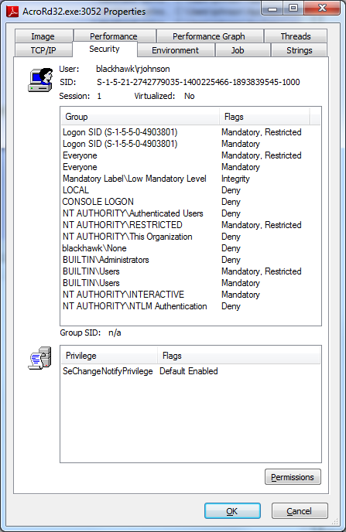
Sandbox Analysis
Token restriction
Adobe Reader X Broker
Adobe Reader X Renderer
Notes:
NTLM authentication is restricted but standard socket I/O is okay

Slide 26
Sandbox Analysis
Job limits
Limit of one ActiveProcess
No changing or creating desktops
Cannot use handles associated with another job
Denied access to ChangeDisplaySettings
Denied access to ExitWindows
Denied access to SystemParametersInfo

Slide 27
Sandbox Analysis
Determine IPC mechanisms in use
Trace APIs related to various IPC mechanisms
Catching creation of IPC endpoints can be as simple as using Windbg

Slide 28
Sandbox Analysis
Determine IPC mechanisms in use
Clipboard
COM
Data Copy
DDE
File Mapping
Mailslots
Pipes
RPC
Windows Sockets

Slide 29
Sandbox Analysis
Memory mappings are backed to pagefile and may be named or unnamed
If unnamed, the handle must be passed to the child process via DuplicateHandle

Slide 30
Sandbox Analysis
Windbg can trace mappings for you
r $t0 = 0;
r $t1 = 0;
bp KERNELBASE!CreateFileMappingW ".if (poi(@esp + 4)) = -1 { .echo ; kn 5 ; .printf \"\\nCreateFileMappingW\\nHandle: %x\\n\", poi(@esp + 4) ; ddu esp + 24 l1 ; gu ; .printf \"Mapped Memory Handle: %x\\n\\n\", @eax ; r $t0 = @eax ; g } .else { g } "
bp KERNELBASE!MapViewOfFile ".if (poi(@esp + 4)) = $t0 { r $t1 = poi(@esp + 24) ; .echo ; kn 5 ; gu ; .printf \"\\nMapViewOfFile\\nMapped Address: %x Size: %d\\nSetting memory breakpoint\\n\\n\", @eax, @$t1 ; ba r 4 @eax \".echo Mapped Memory Access ; kn 4 ; ub ; g\" ; g } .else { g } "
bp KERNELBASE!OpenFileMappingW "kn 5 ; .echo ; .printf \"OpenFileMappingW\nPath: [%mu]\", poi(@esp + c) ; .if(poi(@esp + 4)) & 2 { .printf \" FILE_MAP_WRITE\" } ; .if(poi(@esp + 4)) & 4 { .printf \" FILE_MAP_READ\" } ; .echo ; .echo ; g"
bp DuplicateHandle ".echo ; .printf \"DuplicateHandle: %x\", poi(@esp + 8) ; .echo ; .echo ; g"
bp ConnectNamedPipe
bp CreateNamedPipeW
bp AcroRd32Exe+0xc08f ".echo Attach to client”

Slide 31
Sandbox Analysis
Windbg can trace mappings for you
# ChildEBP RetAddr
00 0041ec44 7700ac7e KERNELBASE!OpenFileMappingW
01 0041ec60 7700ac11 SHLWAPI!SHCreateSharedSection+0x16
02 0041ec90 7700acf6 SHLWAPI!OpenGlobalCounterFileMappingAndMapMemory+0x3d
03 0041eca8 7700e9de SHLWAPI!GetGlobalCounterMemoryAddress+0x3d
04 0041ecb4 75dac572 SHLWAPI!SHGlobalCounterGetValue+0xd
OpenFileMappingW Path: [windows_shell_global_counters] FILE_MAP_WRITE FILE_MAP_READ
--------------------
DuplicateHandle: 1e4
--------------------
# ChildEBP RetAddr
00 0041f0f0 00f2f824 KERNELBASE!CreateFileMappingW
01 0041f118 00f3023b AcroRd32Exe+0x1f824
02 0041f138 00f2e438 AcroRd32Exe+0x2023b
03 0041f230 00f4bf6b AcroRd32Exe+0x1e438
04 0041f360 00f1bdfa AcroRd32Exe+0x3bf6b
CreateFileMappingW
Handle: ffffffff
0041f118 0041f138 ".A.ò쿐৬.A찔.꼨.戅ø"
Mapped Memory Handle: 220
--------------------
DuplicateHandle: 220

Slide 32
Sandbox Analysis
Windbg can trace mappings for you
# ChildEBP RetAddr
00 0041f0f0 00f2f870 KERNELBASE!MapViewOfFile
01 0041f118 00f3023b AcroRd32Exe+0x1f870
02 0041f138 00f2e438 AcroRd32Exe+0x2023b
03 0041f230 00f4bf6b AcroRd32Exe+0x1e438
04 0041f360 00f1bdfa AcroRd32Exe+0x3bf6b
--------------------
MapViewOfFile
Mapped Address: a4a0000 Size: 4321592 Setting memory breakpoint
--------------------
Mapped Memory Access
# ChildEBP RetAddr
00 0041f0f8 00f2f963 AcroRd32Exe+0x237ac
01 0041f118 00f3023b AcroRd32Exe+0x1f963
02 0041f138 00f2e438 AcroRd32Exe+0x2023b
03 0041f230 00f4bf6b AcroRd32Exe+0x1e438
AcroRd32Exe+0x23795:
00f33797 8d0480 lea eax,[eax+eax*4]
00f3379a 8d148508000000 lea edx,[eax*4+8]
00f337a1 8b4508 mov eax,dword ptr [ebp+8]
00f337a4 53 push ebx
00f337a5 8907 mov dword ptr [edi],eax
00f337a7 8955fc mov dword ptr [ebp-4],edx
00f337aa 8908 mov dword ptr [eax],ecx

Slide 33
Attacking IPC Message Format
Adobe uses a shared memory structure to request resources from the broker process
This additional attack surface deserves a critical look from a code quality perspective
We can inject a DLL to request resources in a loop with corrupt values

Slide 34
Attacking IPC Message Format
Inject a DLL for fuzzing
int InjectDLL(HANDLE hProcess, char *moduleName)
{
unsigned char *remoteBuffer;
LPTHREAD_START_ROUTINE loadLibraryAddr;
HANDLE hThread;
DWORD moduleNameLen, ret;
moduleNameLen = strlen(moduleName) + 1;
remoteBuffer = (unsigned char *)VirtualAllocEx(
hProcess, NULL, moduleNameLen, MEM_COMMIT, PAGE_READWRITE);
WriteProcessMemory(hProcess, remoteBuffer , moduleName, moduleNameLen, NULL);
loadLibraryAddr = (LPTHREAD_START_ROUTINE)GetProcAddress(
GetModuleHandleA("kernel32.dll"), "LoadLibraryA");
hThread = CreateRemoteThread(
hProcess, NULL, 0, loadLibraryAddr, (void *)remoteBuffer, 0, NULL);
ret = WaitForSingleObject(hThread, 5 * 1000);
...
}

Slide 35
Attacking IPC Message Format
Fuzz from within the DLL
BOOL APIENTRY DllMain(HANDLE hModule, DWORD dwReason, LPVOID lpReserved)
{
if(dwReason == DLL_PROCESS_ATTACH )
{
MessageBoxA(NULL, "Dll injected!", "Fuzzer Dll", MB_OK);
if((hFuzzThread = CreateThread(
NULL, // default security attributes
0, // use default stack size
FuzzerFunction, // thread function name
NULL, // argument to thread function
0, // use default creation flags
&dwFuzzThreadId)) == NULL) // returns the thread identifier
{
MessageBoxA(NULL, "Failed to create fuzzing thread", "Fuzzer Dll", MB_OK);
}
...
}
return TRUE;
}

Slide 36
Attacking IPC Message Format
Fuzz from within the DLL
DWORD WINAPI FuzzerFunction(LPVOID lpParam)
{
DWORD iteration = 0;
FILE *file;
do
{
char *path = GenFuzzedString();
file = fopen(path, "r");
if(file != NULL)
fclose(file);
file = fopen(path, "w");
if(file != NULL)
fclose(file);
...
} while (iteration++ < ITERATIONS);
return 0;
}

Slide 37
If All Else Fails
Kernel exploitation will bypass ALL usermode sandbox architectures
Download the slides and whitepaper from yesterday’s talk on Windows Kernel Exploitation

Slide 38
Unrestricted Access
Socket and Handle use is not restricted
Could use PDF exploit as a pivot point into a sensitive network using less sophisticated attacks to achieve persistence
Reading of the file system is not restricted
Combined with above flaw, file system may be dumped over a socket

Slide 39
Unrestricted Access
Reading from Clipboard is not restricted
Log file is disabled by default
When it is enabled, it is stored in one of the few writable directories by default

Slide 40
Future Potential
Network Sandboxing (LeBlanc)
A solution is outlined in http://blogs.msdn.com/b/david_leblanc/archive/2007/11/02/more-on-sandboxing-network-implications.aspx
tl;dr – Use Windows Firewall to limit connections to and from the acrord32.exe process

Slide 41
Future Potential
File I/O Sandboxing (rjohnson)
On launch copy required resources to a temp directory
Limit all reads to the temp directory rather than allowing global read access

Slide 42
Future Potential
Utilize 64-bit process advantages (anti-spray)
Javascript blacklist could be utilized to prevent loading of generic spray code
Currently only blacklist APIs rather than allow a fingerprinting mechanism
Embedded Flash interpreter should gain same sandbox as in the browser

Slide 43
Conclusion
Adobe is moving in the right direction
Improvements need to be implemented on other platforms
Offering configuration that includes the ability to enable available solutions would lead to a more secure sandbox

Slide 44
Questions?
Thank you!
rjohnson@sourcefire.com
http://vrt-blog.snort.org/
@richinseattle

